Slide 1
SQL Databases
aaah

Slide 2
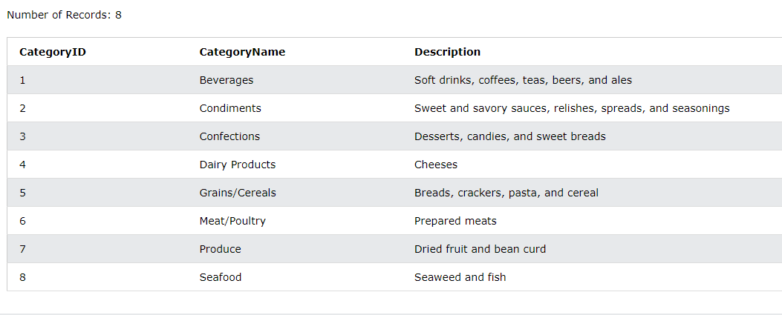
Select statement
„SELECT * FROM [Categories];”

Slide 3
Insert data
INSERT INTO Customers (CustomerName, ContactName) VALUES('Gyula cége', 'János');

Slide 4
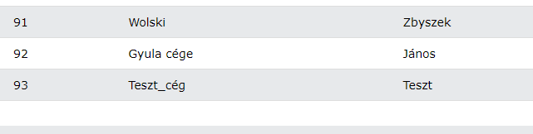
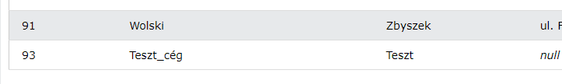
Deletion of Data
DELETE FROM Customers WHERE CustomerName = 'Gyula cége’;

Slide 5

Update
UPDATE Customers SET CustomerID = 92 WHERE CustomerName = ‚Teszt_cég’

Slide 6
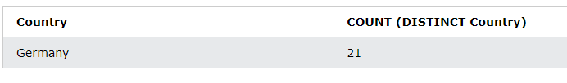
Distinct Csak eredeti értékeket számol, Ismétléseket kihagyja
SELECT Country, COUNT (DISTINCT Country) FROM Customers;

Slide 7
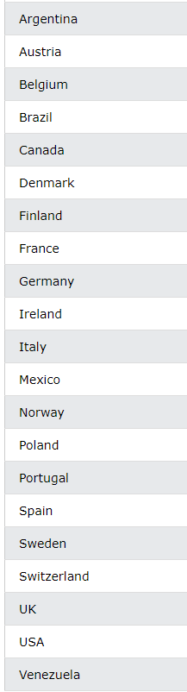
Order BY
SELECT DISTINCT Country FROM Customers, WHERE Country NOT null ORDER BY Country ASC;

Slide 8
Hány row-t adjon vissza Legidősebb ember
SELECT * FROM [Employees] ORDER BY BirthDate limit 1;

Slide 9
Missing character „_”: single character „%”: any number of characters
SELECT * FROM [Employees] where Notes LIKE '_du%'

